Slide 1
Shoulder biomechanics
Ed Chadwick
Frans van der Helm
Man-Machine Systems & Control group
Dept. of Mechanical Engineering
Delft University of Technology, Delft

Slide 2
Inverse dynamic simulations
Musculo-
skeletal
model
Recorded motions
External forces
Muscle length
Moment arms
Muscle force
Joint reaction force
Moment equilibrium
Power balance
Functional analysis
Testing hypotheses, what-if questions

Slide 3
Contents
General introduction
Kinematics
  Degrees of Freedom
  Segment motions and joint motions
  Motion recording
  Visualisation
Dynamics
  Inverse dynamic model
  Motion equations
  Muscle dynamics
  Inverse/Forward dynamic optimization
  Applications in Computer Assisted Surgery
    Scapula fracture
    GH endoprosthesis
    Serratus tendon transfer
    Latissimus dorsi and teres major transfer
    Inverse endoprosthesis

Slide 4
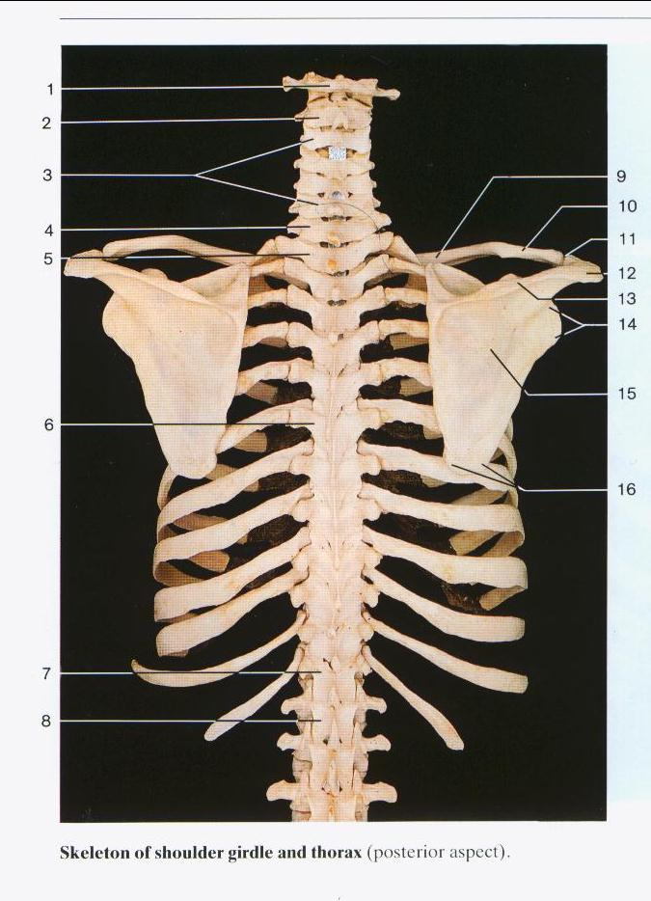
Shoulder bones
Motion constraints due to closed chain
thorax-clavicle-scapula-thorax
  Forced rotations of scapula
  Muscle actions around SC-joint and AC-joint are coupled
Simultaneous motions shoulder girdle and humerus: Scapulohumeral rhythm

Slide 5
Joint Degrees-of-Freedom
# Degrees of Freedom joint depends on:
  Shape of articular surface
  Number of ligaments
Model Choice !!
  Small translations & rotations are neglected

Slide 6
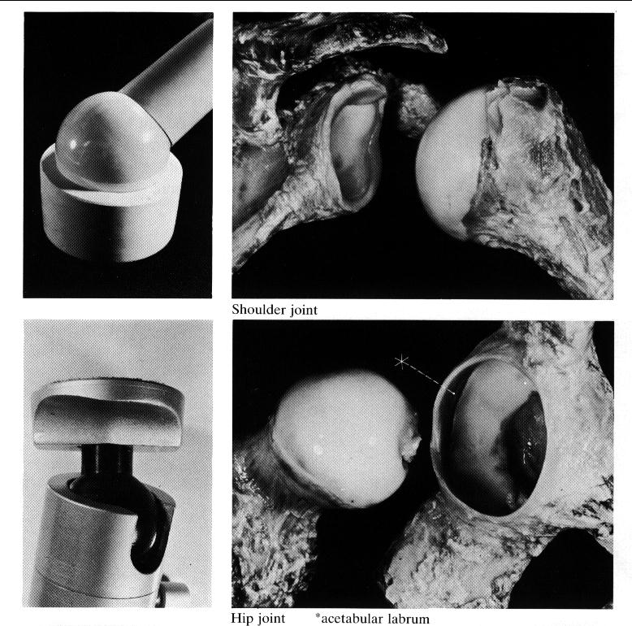
Ball-and-socket joint

Slide 7
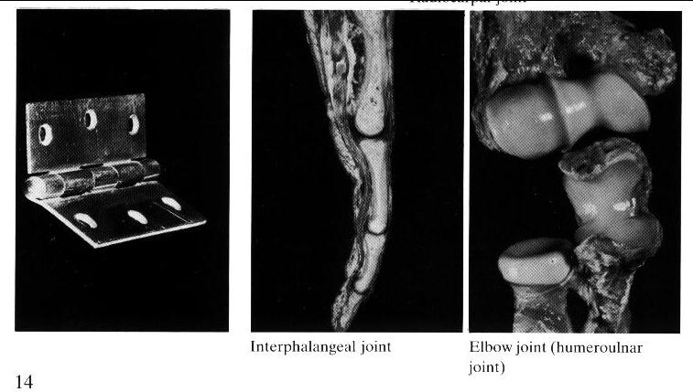
Hinge joint

Slide 8
Degrees-of-Freedom Shoulder & Elbow
Thorax w.r.t. Global: 6 DOF
Sternoclavicular joint: 3 DOF
Acromioclavicular joint: 3 DOF
Scapulothoracic gliding plane: -2 DOF
Conoid ligament: -1 DOF
Glenohumeral joint: 3 DOF
Humero-ulnar joint: 1 DOF
Ulno-radial joint: 1 DOF
Wrist: 3 DOF
Total 17 DOF
Kinematic (net moments) 9 DOF
Dynamic (optimized muscle forces) 8 DOF

Slide 9
Input motions
3 thorax rotations
3 thorax positions
3 DOF shoulder girdle (~ rotations AC/SC joints)
3 glenohumeral rotations
1 elbow flexion/extension
1 forearm pro/supination
3 wrist rotations (~ hand position)

Slide 10
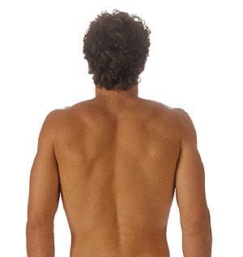
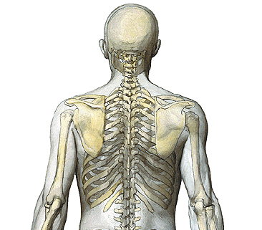
Kinematics relatively large subcutaneous movements
Illustrations from Sobotta 1.5

Slide 11
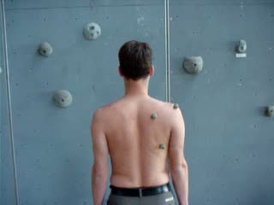
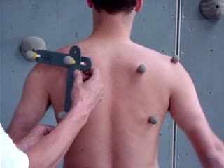
Kinematics problems with surface markers

Slide 12
Kinematics measurement procedures I
Initial measurements
  relationship between technical markers and anatomical landmarks
  estimation of rotation center of humerus (= proximal marker)
    IHA calculations
    regression equations
    spherical fit
experiment
data processing
  segment rotations
    thorax relative to global coordinate system
    humerus relative to thorax coordinate system
    ulna relative to humerus
    radius relative to ulna

Slide 13
Kinematics measurement procedures II
data processing (continued)
  estimation clavicular rotations relative to the thorax
    difficult to measure ⇒minimization of rotation in AC
  estimation scapular rotations relative to the thorax
    from direct measurements
    individually based regression equations (dynamic -> static)
    regression equations from the literature
Notes:
From Pascoal AG (2001) Ombro e Elevacao do Braco, PhD thesis UT. Lisbon

Slide 14
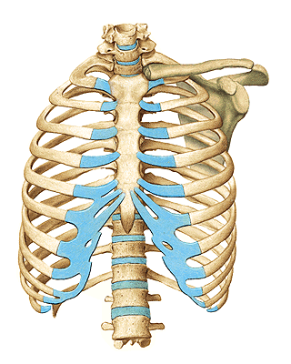
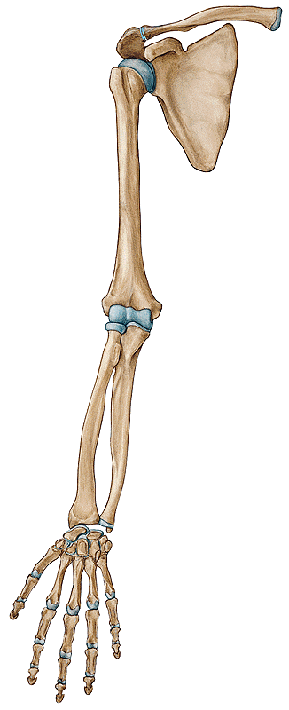
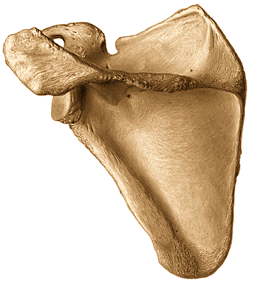
Definition of Anatomical landmarks
C7
T8
Incisura Jugularis (IJ)
Processus Xiphoideus (PX)
Art. Sternoclaviculare (SC)
Art. Acromioclaviculare (AC)
Trigonum Scapulae (TS)
Angulus Inferior (AI)
Angulus Acromialis (AA)
Processus coracoideus (PC)
Glenohumeral rotation centre (GH)
Lateral epicondyle (EL)
Medial epicondyle (EM)
Radial styloid (RS)
Ulnar styloid (US)
Illustrations from Sobotta 1.5

Slide 15
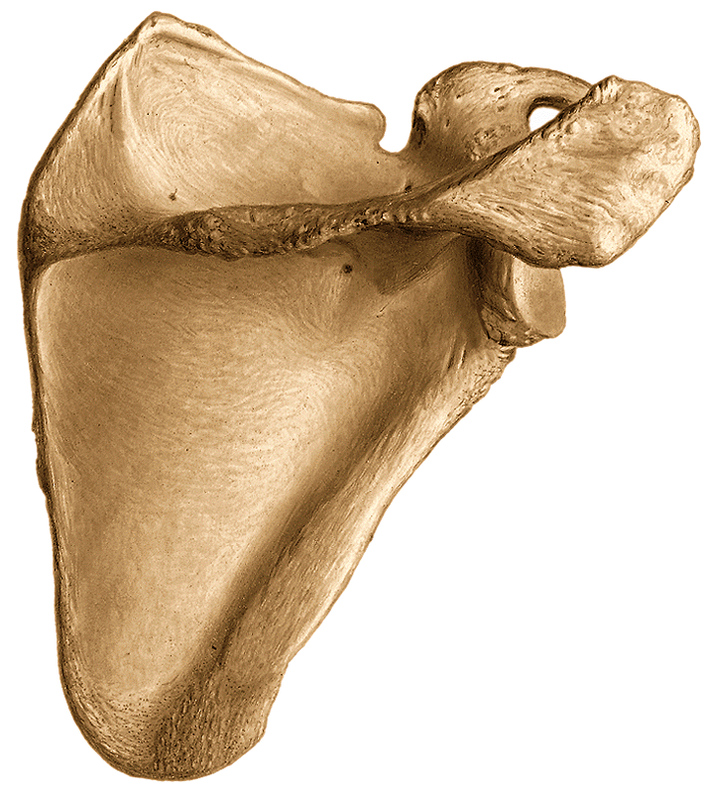
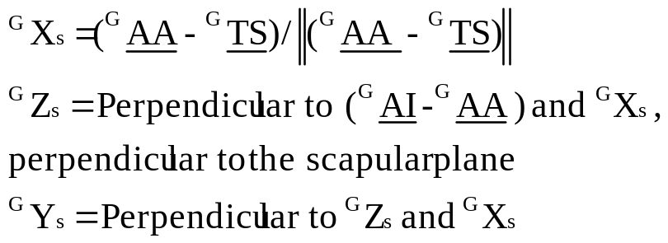
Initial measurements
Ys
Ys
Definition of local coordinate systems and technical marker frames
  three bony landmarks needed
example: scapula
Xs
TS
Xs
AA
Zs
Zs
AI

Slide 16
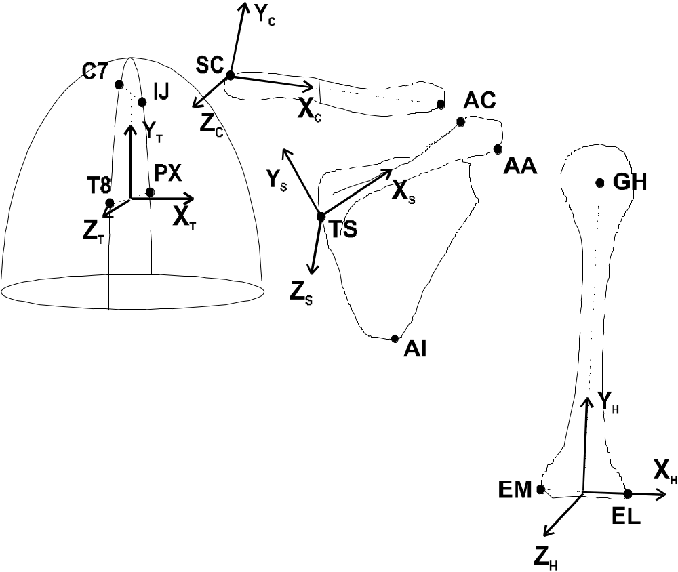
Definition of local co-ordinate systems with respect to bony landmarks
dorsal view

Slide 17
Choice of tracking markers
3-D video: reflexive or active markers
3-D x-ray: inserted tantalum balls
electromagnetic tracking device: sensors

Slide 18
Steps in measurement session
Step 1: Attach tracking markers/sensors to segments
Step 2: Record bony landmarks w.r.t. tracking markers
Step 3: Record tracking markers during motion
Step 4: Reconstruct bony landmarks during motion
Step 5: Calculate local coordinate systems using bony landmarks
Step 6: Calculate rotations between local coordinate systems

Slide 19
Motion description
Choice of reference frame
  Bone rotations: With respect to thorax
  Joint rotations: With respect to proximal bone
Order of rotation
  Euler angles: sequence of three rotations
  Intuitively
  Close to medical terminology
  Avoidance of Gimbal Lock orientations

Slide 20
Motion description:
Choice of reference frame
Bone rotations:
Thorax w.r.t. Global
Clavicle w.r.t. Thorax
Scapula w.r.t. Thorax
Humerus w.r.t. Thorax
Joint rotations:
Thorax w.r.t. Global
Sternoclavicular joint:
  Clavicle w.r.t. Thorax
Acromioclavicular joint:
  Scapula w.r.t. Clavicle
Glenohumeral joint:
  Humerus w.r.t. Scapula

Slide 21
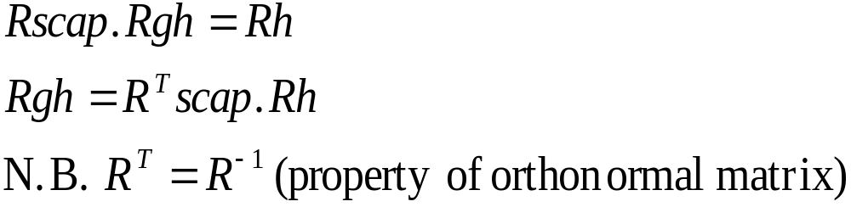
Calculation of rotation matrix
Rscap: Orientation scapula w.r.t. global coordinate system
Rhum: Orientation humerus w.r.t. global coordinate system
Rgh: Rotations of humerus w.r.t. scapula = glenohumeral joint rotations

Slide 22
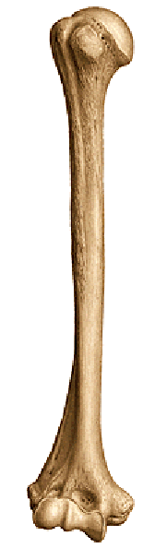
Initial measurements
Proximal marker on humerus difficult to define!
  Regression equations for center humeral head, relative to scapular landmarks
    Meskers et al (1998)
  Screw-axis method
    Veeger et al (1996)
    Stokdijk et al (2000)
  spherical fit
    Stokdijk et al (2000)
Notes:
Regression equations for estimation of the position of the GH rotation center (data in mm.):
GHx=18.9743 + 0.2434 * PCx + 0.2341 * AIx + 0.1590 * [Lai-aa] + 0.0558 * PCy
GHy=-3.8791 - 0.1002 * [Lac-pc] + 0.1732 * PCy - 0.3940 * [Lac-aa] + 0.1205 * AIx
GHz=-9.2629 - 0.2403 * PCy + 1.0255 * PCz + 0.1720 *[Lts-pc]
from Meskers CGM, Vermeulen HM, de Groot JH, Van der Helm FCT, Rozing PM (1998ª). 3D shoulder position measurements using a six-degrees-of-freedom electromagnetic tracking device. Clin. Biomech. 13, 280-292.
Methods for calculation of screw axes, applied to the shoulder (and arm) can be found in:
Stokdijk M, Nagels J, Rozing PM (2000). The glenohumeral joint rotation centre in vivo. J. Biomech. 33(12), 1629-1636.
Veeger HEJ, Yu B, An KN (1996) Orientation of axes in the elbow and forearm for biomechanical modeling. In: Veeger HEJ, Van der Helm FCT, Rozing PM (Eds.), Proc. of the First Conf. of the Int. Shoulder Group, Shaker Publishing, Maastricht, ISBN 90-423-0008-6, pp. 83-87.
Relevant software:
ghestnew.m -> regression equations scapula
iha_rel.m -> estimation of instantaneous screw axes
see: http://www.wbmt.tudelft.nl/mms/dsg/intersg/software/kinematics/

Slide 23
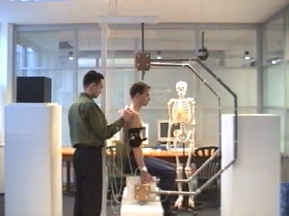
Example of measurement procedures I static & Electromagnetic system
Direct measurement of scapula position

Slide 24
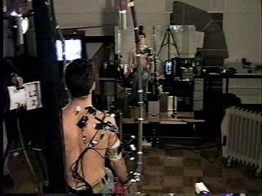
Example of measurement procedures II dynamix and opto-electronic system
Estimation of scapula position from regression equations

Slide 25
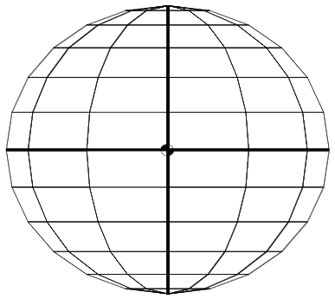
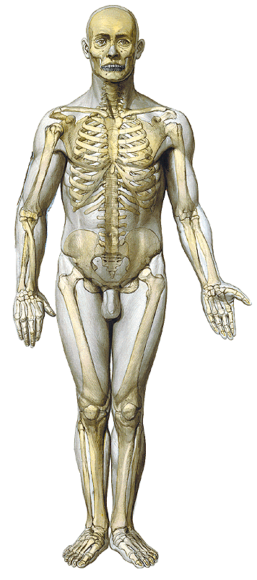
Data processing: Thorax rotations
150°
180°
120°
90°
30°
60°
90°
120°
150°
60°
30°
0°
Yt
Yt
Yt
Zt
Zt
Zt
Xt
Xt
Xt
Backward
rotation
Torsion
Lateral
rotation

Slide 26
Data processing: Clavicula rotations
Yt
Zt
Xt
Yc
Yc
Yc
Zc
Zc
Zc
Xc
Xc
Xc
Pro/retraction
Elevation
Axial rotation

Slide 27
Data processing: Scapula rotations
Yt
Zt
Xt
Ys
Ys
Ys
Zs
Xs
Xs
Zs
Zs
Pro/retraction
A-P tilt
Lateral rotation

Slide 28
Data processing: Humerus rotations
Yt
Zt
Xt
Yh
Yh
Yh
Xh
Zh
Xh
Zh
Xh
Zh
Plane of elevation
Elevation angle
Axial rotation

Slide 29
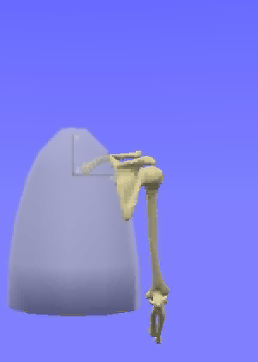
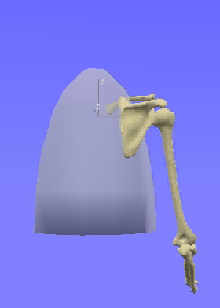
Visualization of recorded motions
(combing hair)
Healthy subject
Patient

Slide 30
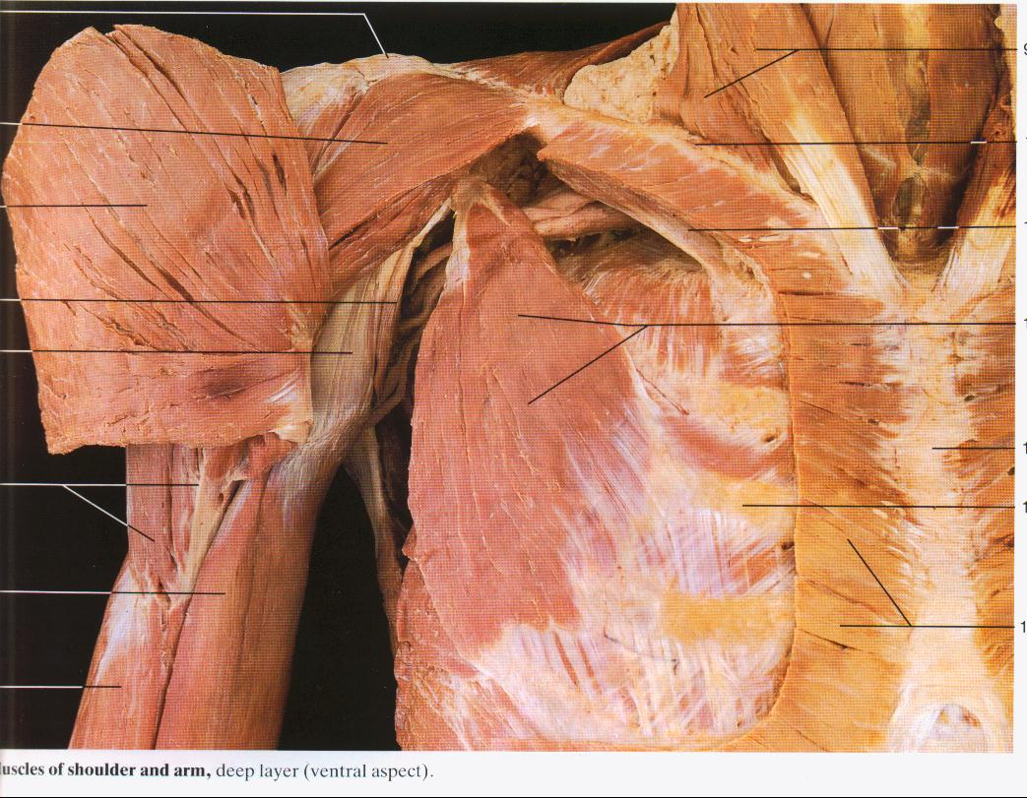
Shoulder and elbow muscles
31 muscles and muscle parts
  large attachment sites
  many poly-articular
  muscle parts contract independently
Muscle actions are coupled
  co-ordination
  force generation
  stability
    compensate other muscles
    compensate external perturbations

